Slide 1
Retail Superstore Sales Performance Analysis
SQL + Power BI
Presented by
Busayo Omoniyi

Slide 2
Global Superstore wanted to understand how its sales performance, profitability, customer behavior, and product performance changed over time.
Using SQL for data analysis and Power BI for visualization, I analyzed transactional data to identify trends, uncover business opportunities, and provide actionable recommendations that support better decision-making.
Objective
Transform raw sales data into meaningful business insights through data cleaning, SQL analysis, interactive dashboards, and data storytelling.
Project Overview
TOOLS:
SQL
Power BI
Excel
----------------
DATASET:
Global Superstore
----------------
ROLE:
Data Analyst

Slide 3
How is overall sales performance changing over time?
Which regions, categories, and customer segments generate the highest revenue?
01
02
Business Questions
Which products require management attention?
Which product categories contribute the most to profit?
06
03
Who are the company's most valuable customers?
How do discounts affect profitability?
05
04
This analysis was conducted to answer the above business questions

Slide 4
Data Understanding and Preparation
Before beginning the analysis, the dataset was explored to understand its structure, data types, and overall quality.
The preparation process included:
1. Reviewing all variables and their business meaning
2. Identifying missing values and inconsistencies
3. Cleaning and standardizing the dataset
4. Preparing the data for SQL analysis and Power BI visualization
This ensured the analysis was based on reliable and consistent data.
Raw Dataset
↓
Data Cleaning
↓
Exploratory Analysis
↓
SQL Analysis
↓
Power BI Dashboard
↓
Business Insights
↓
Recommendations

Slide 5
SQL Analysis
SQL was used to explore the dataset, answer key business questions, and prepare insights for visualization.
The analysis focused on:
Sales performance
Product performance
01
04
Profitability
Discount impact
02
05
Customer behavior
Time-based trends
03
06
The resulting insights formed the foundation of the interactive Power BI dashboard.

Slide 6
EXECUTIVE DASHBOARD

Slide 7
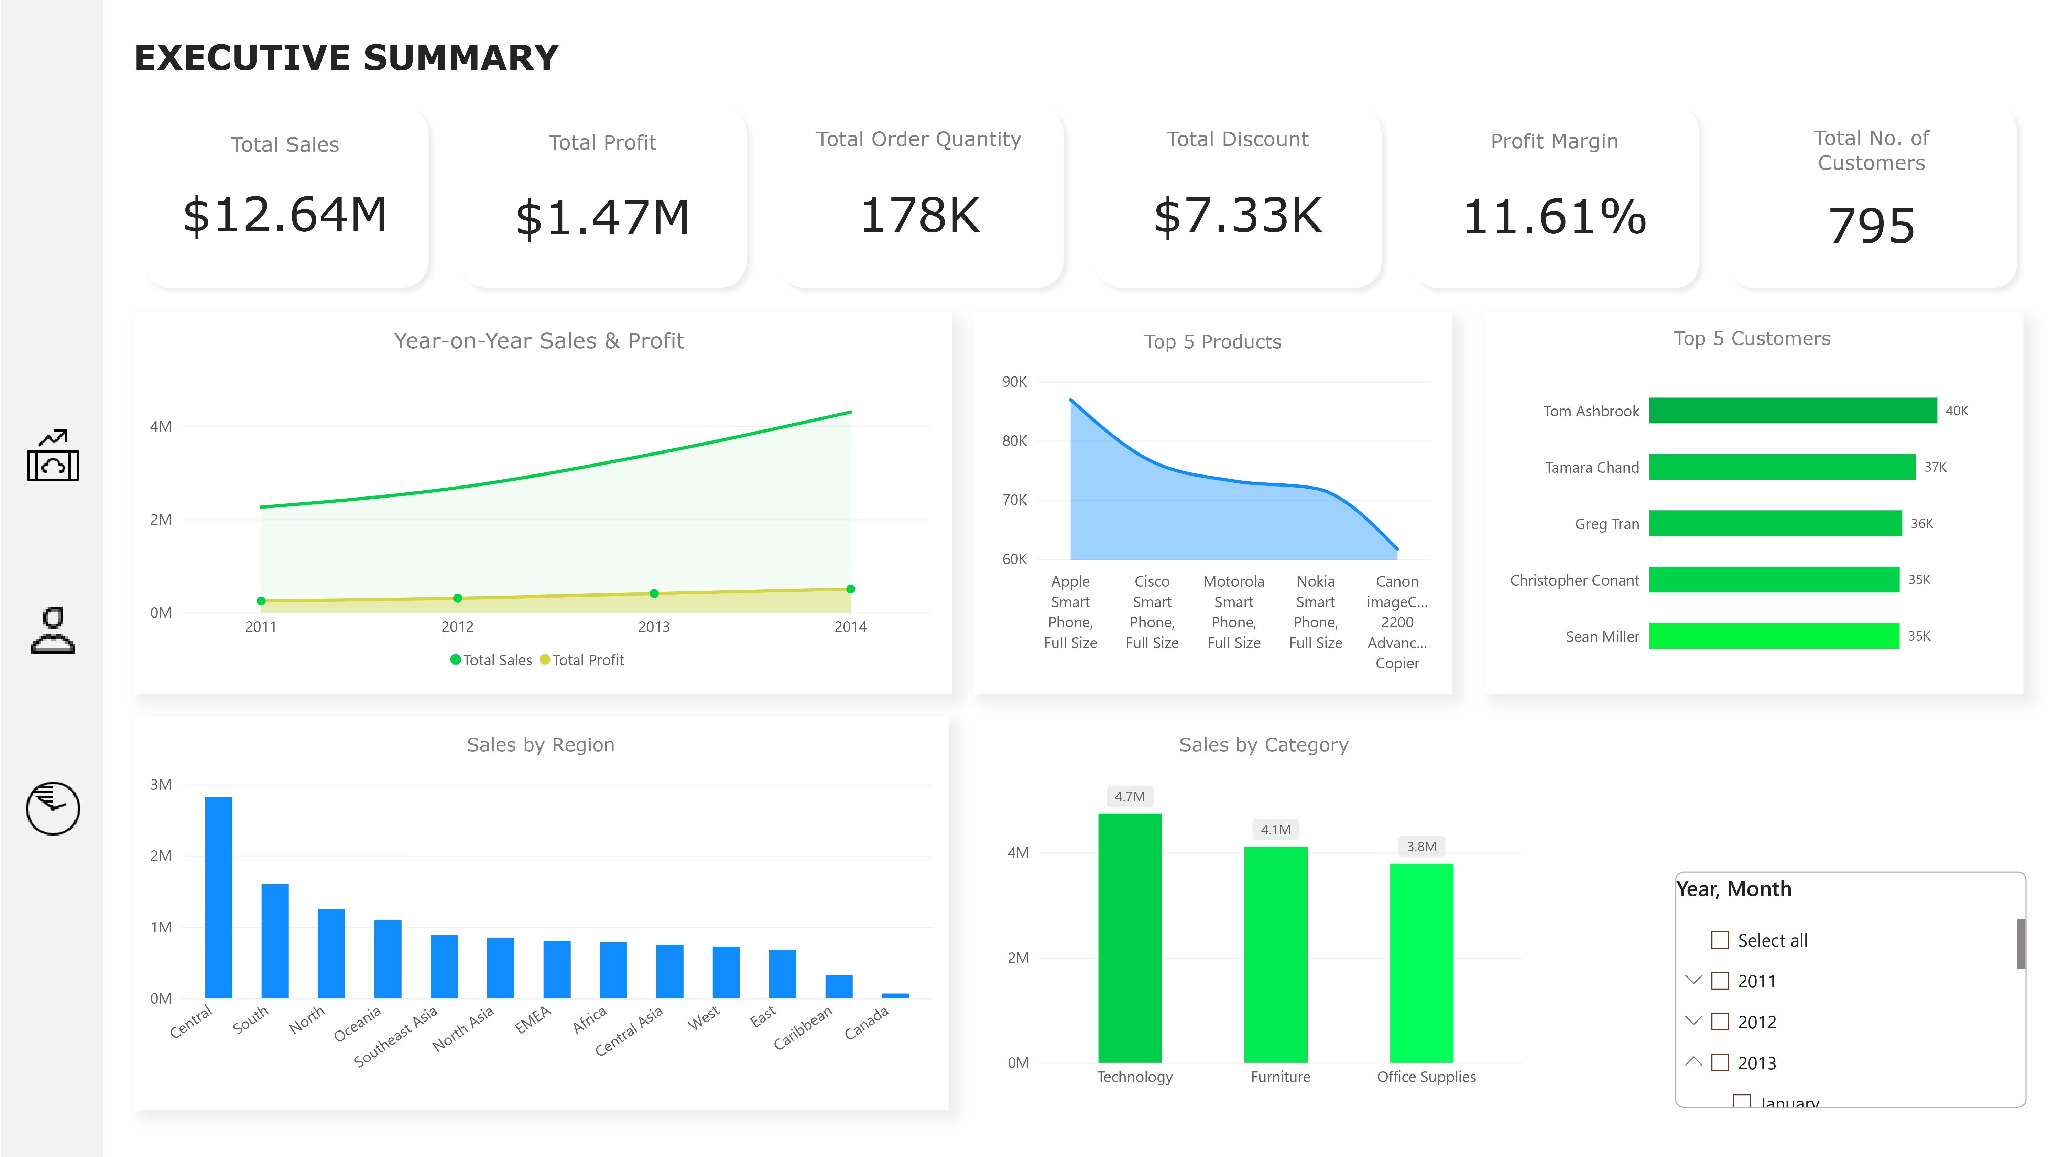

Slide 8
Executive Insight
Business Question 1: How is the business performing overall?
Finding
Sales increased steadily between 2011 and 2014, with 2014 recording the strongest overall performance. The business also exhibits a clear seasonal trend, as Q4, particularly November and December, consistently generated the highest sales, with November 2014 reaching a peak of 555,312.
Business Impact
The recurring Q4 sales surge presents an opportunity to maximize revenue through proactive inventory planning, marketing campaigns, and staffing.

Slide 9
EXECUTIVE INSIGHT
Business Question 2: Which regions, categories, and customer segments generate the highest revenue?
Finding
The Central region generated the highest revenue (2.82M), while the United States emerged as the company's strongest market (2.30M). Across customer segments, the Consumer segment contributed the largest share of revenue.
Business Impact
The Central region, United States, and Consumer segment represent the company's primary revenue drivers and should remain strategic priorities for investment and customer retention.

Slide 10
PROFITABILITY
DASHBOARD

Slide 11
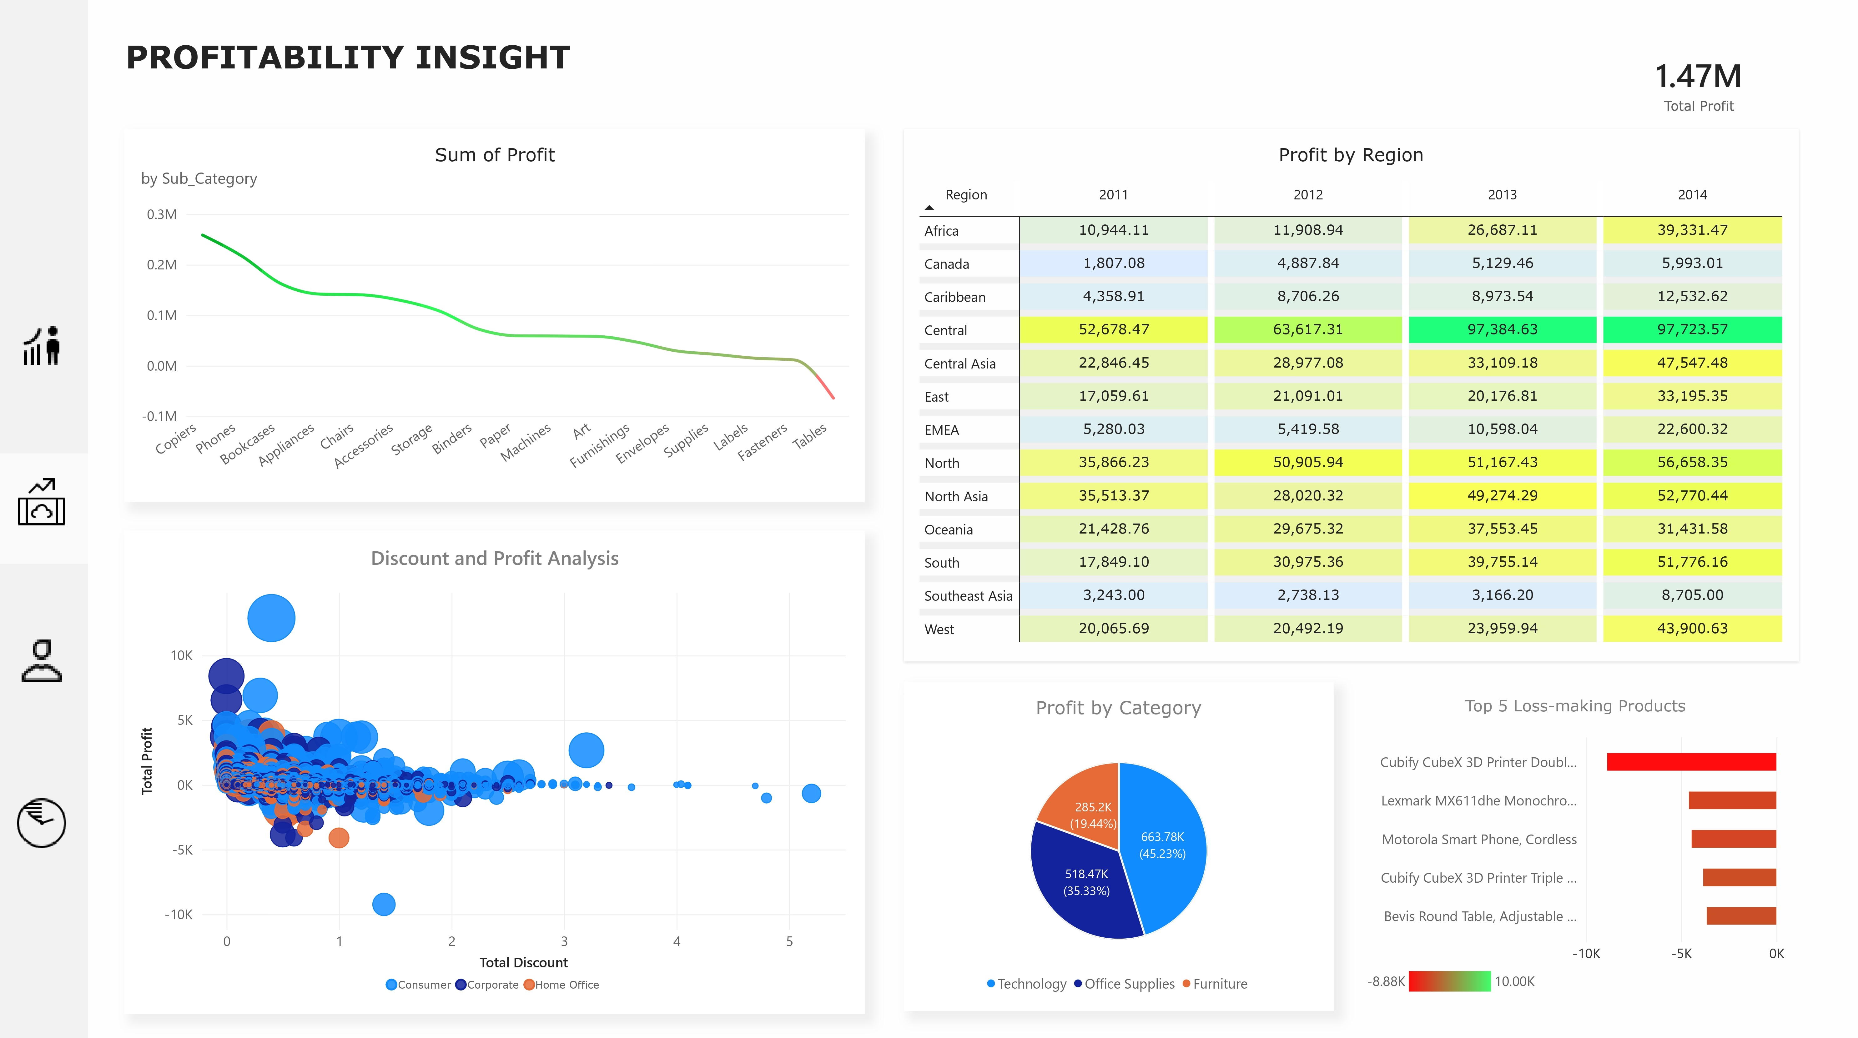

Slide 12
Profitability Insight
Business Question 3: Which product categories contribute the most to profit?
Finding
The Technology category generated the highest profit, making it the company's strongest contributor to overall profitability.
Business Impact
Technology products should remain a strategic focus while management reviews lower-performing categories to identify opportunities for margin improvement.

Slide 13
Discount Insight
Business Question 4: How do discounts affect profitability?
Finding
The analysis shows a negative relationship between discounts and profit. As discount levels increase, profitability generally declines, with heavily discounted transactions more likely to generate low or negative profits.
Business Impact
Discounting should be carefully controlled. Establishing discount thresholds and regularly monitoring their impact can help improve overall profit margins.

Slide 14
CUSTOMER
DASHBOARD

Slide 15
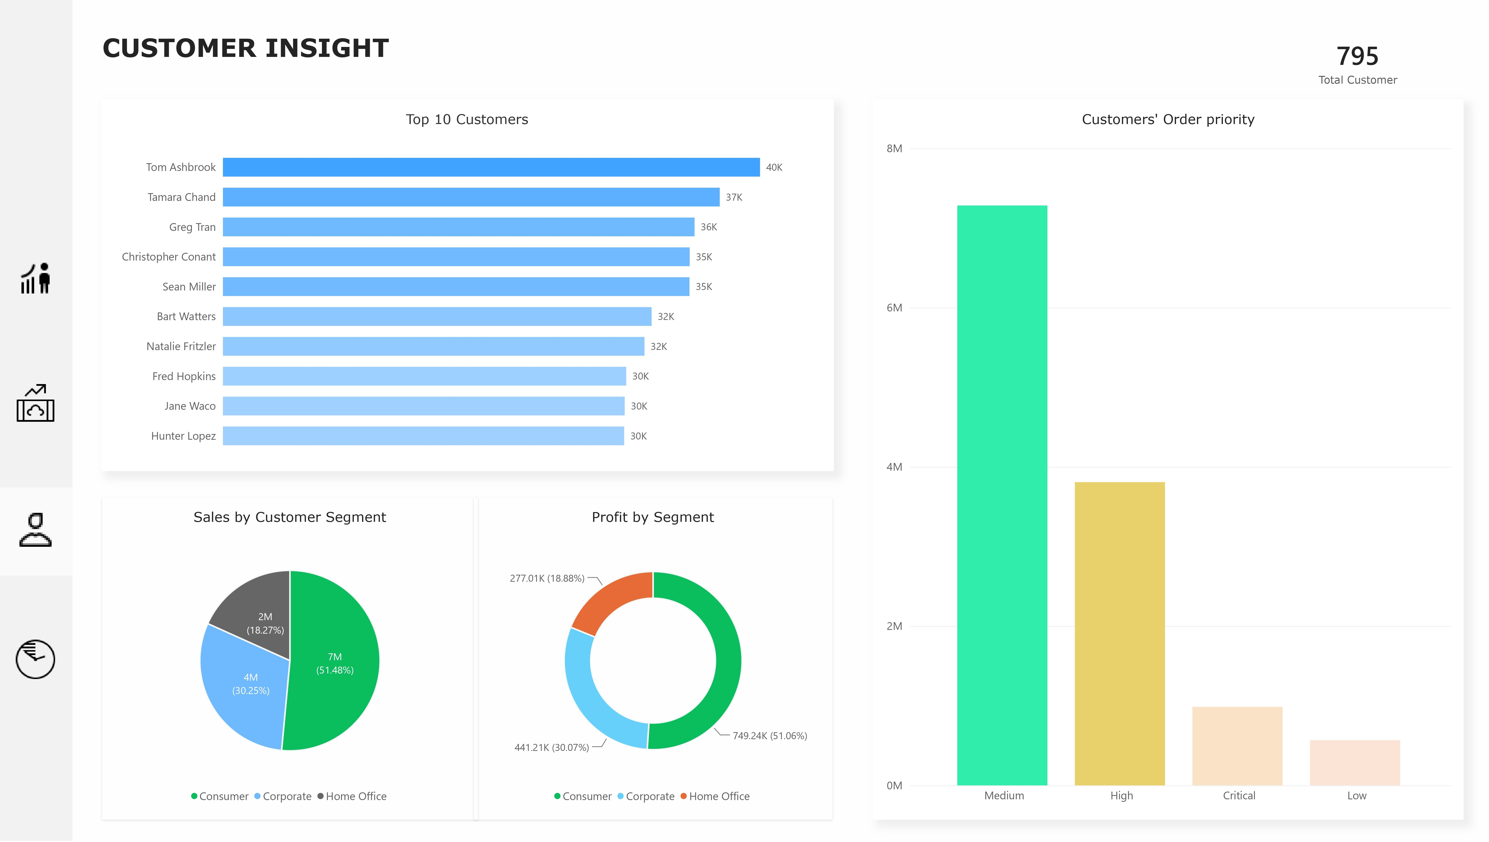

Slide 16
Customer Insight
Business Question 5: Who are the Company’s most valuable custumers
The company serves 795 customers, with revenue concentrated among a relatively small group of high-value accounts. Tom Ashbrook generated the highest sales (40.5K), followed by Tamara Chand, Greg Tran, Christopher Conant, and Sean Miller. While these customers represent only a small fraction of the customer base, they contribute significantly to overall revenue.
Business Impact
Retaining high-value customers should be a strategic priority. Strengthening relationships through loyalty programs, personalized engagement, and dedicated account management can help protect revenue while reducing customer churn.

Slide 17
Products Requiring Immediate Review
Business Question 6: Which products require management attention?
Several premium products, including the Cubify CubeX 3D Printer Double Head, Lexmark MX611dhe Laser Printer, and Motorola Smart Phone, consistently generated losses despite their high market value. These losses may stem from excessive discounting, high procurement costs, warranty expenses, or poor pricing strategies.
Business Impact
Management should review these products to determine whether losses are driven by excessive discounting, high procurement costs, warranty expenses, or pricing strategies. If profitability cannot be improved, discontinuing or repositioning these products should be considered.

Slide 18
TIME ANALYSIS
TREND

Slide 19
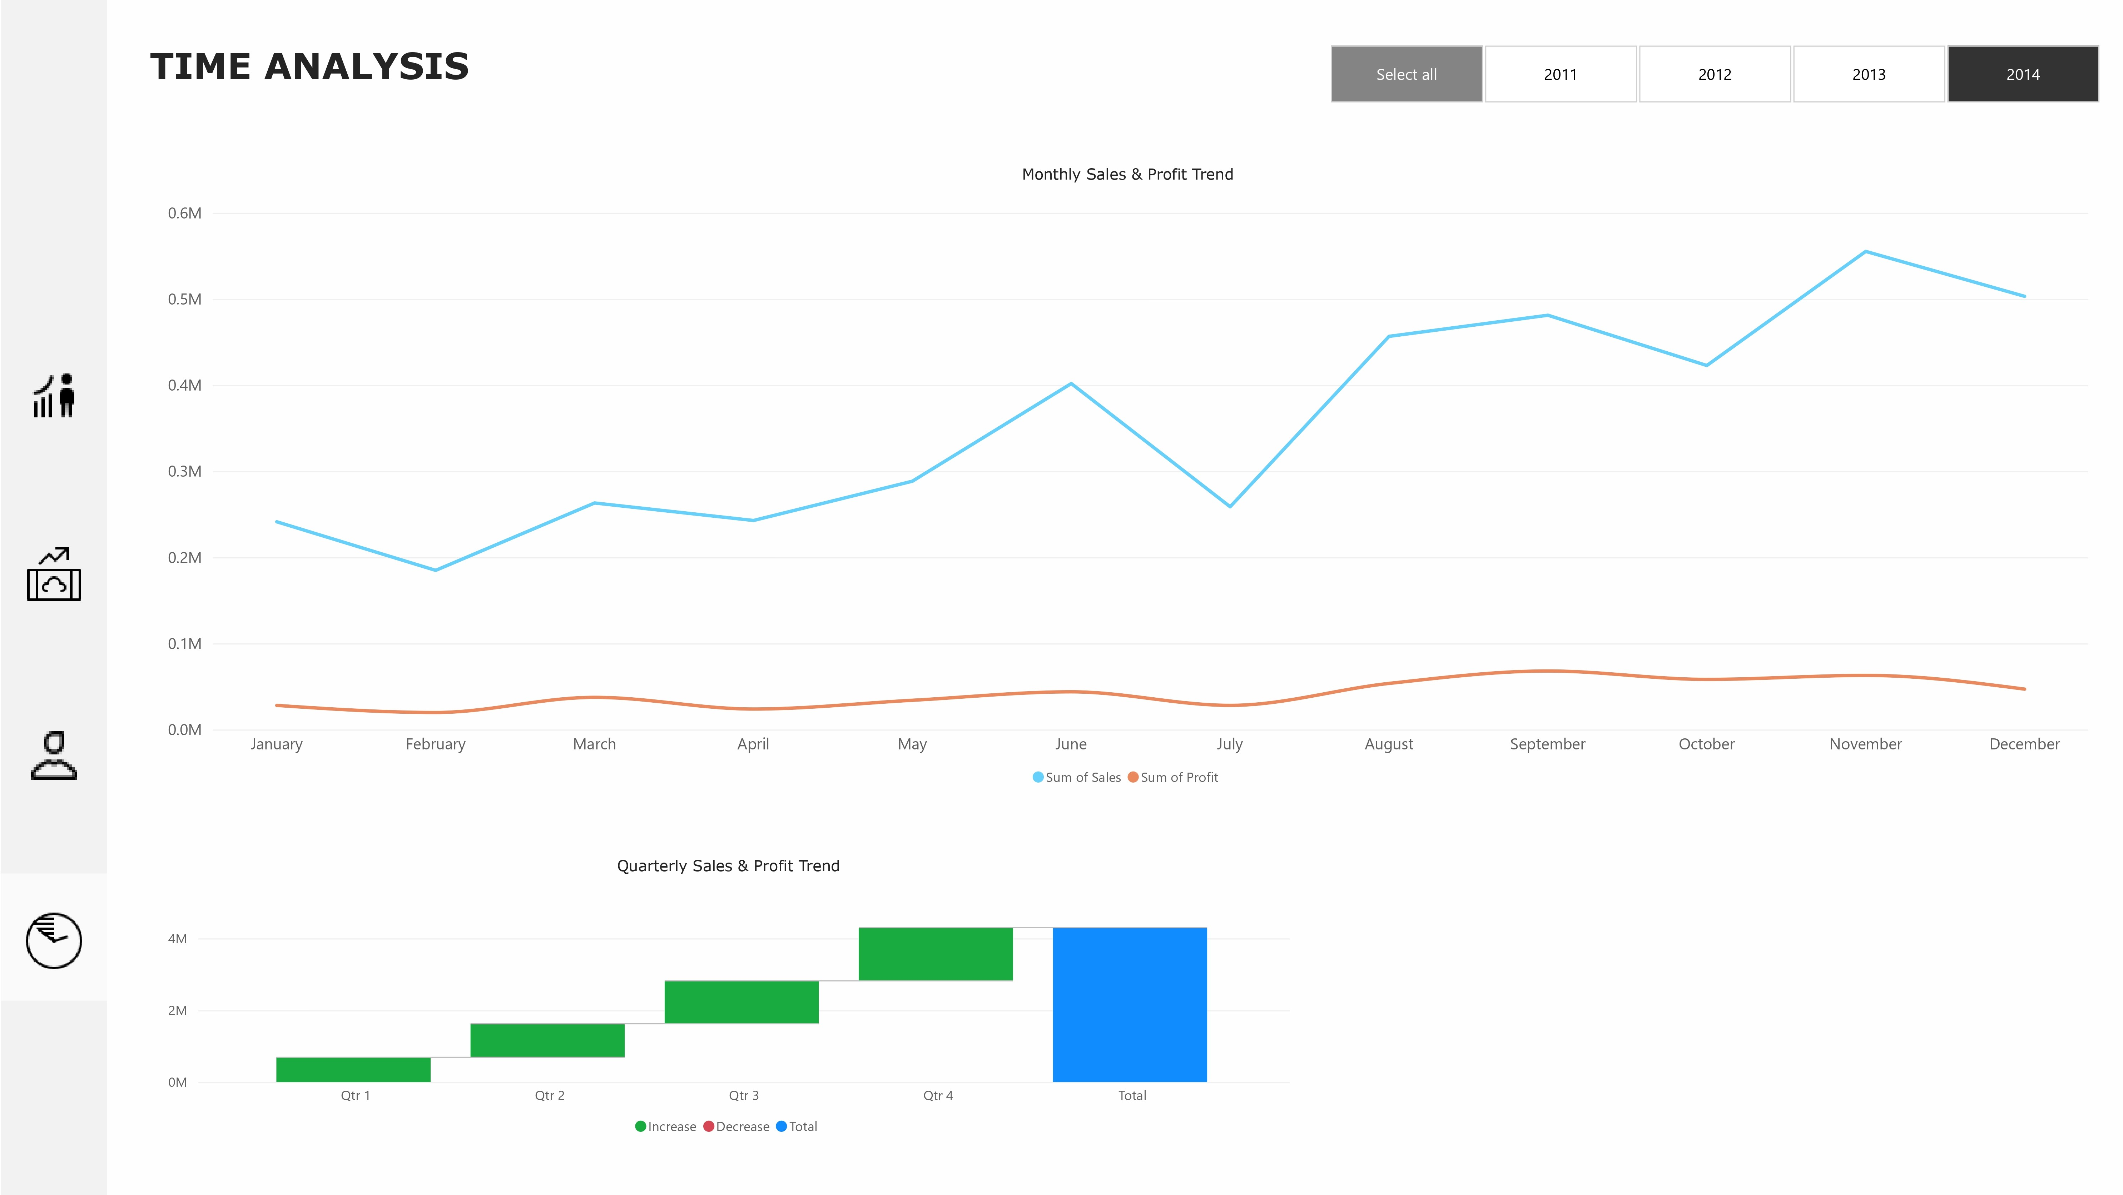

Slide 20
RECOMMENDATIONS
Based on the findings from this analysis, the following actions are recommended to improve sales performance and profitability.

Slide 21
RECOMENDATION
Optimize Discount Strategy
03
Review and standardize discount policies to prevent excessive discounting that erodes profit margins.
Improve Performance in Low-Margin Markets
02
Investigate regions and countries with strong sales but weak profitability to identify pricing, cost, or operational inefficiencies.
01
Capitalize on Peak Sales Periods
Increase inventory, marketing campaigns, and operational capacity ahead of Q4 to maximize revenue during the strongest sales season.

Slide 22
RECOMENDATION
Review Loss-Making Products
06
Assess the pricing, procurement costs, and profitability of consistently loss-making products. Consider repricing, renegotiating supplier costs, or discontinuing products that remain unprofitable.
Build on High-Performing Markets
05
Leverage the strategies driving success in the Central region and the United States to improve performance in underperforming markets.
04
Retain High-Value Customers
Develop loyalty initiatives and personalized engagement strategies for top customers to strengthen long-term customer retention.

Slide 23
THANK YOU
I welcome feedback and opportunities to collaborate on data-driven projects.
Busayo Omoniyi
Data Analyst
Email: hi.busayoniyi@gmail.com
LinkedIn: linkedin.com/in/busayo-omoniyi
GitHub: github.com/Busayo-Omoniyi
Behance: behance.net/busayo-omoniyi

Slide 24
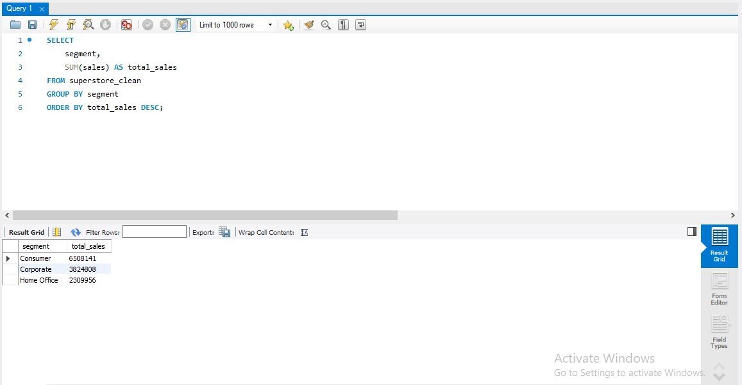
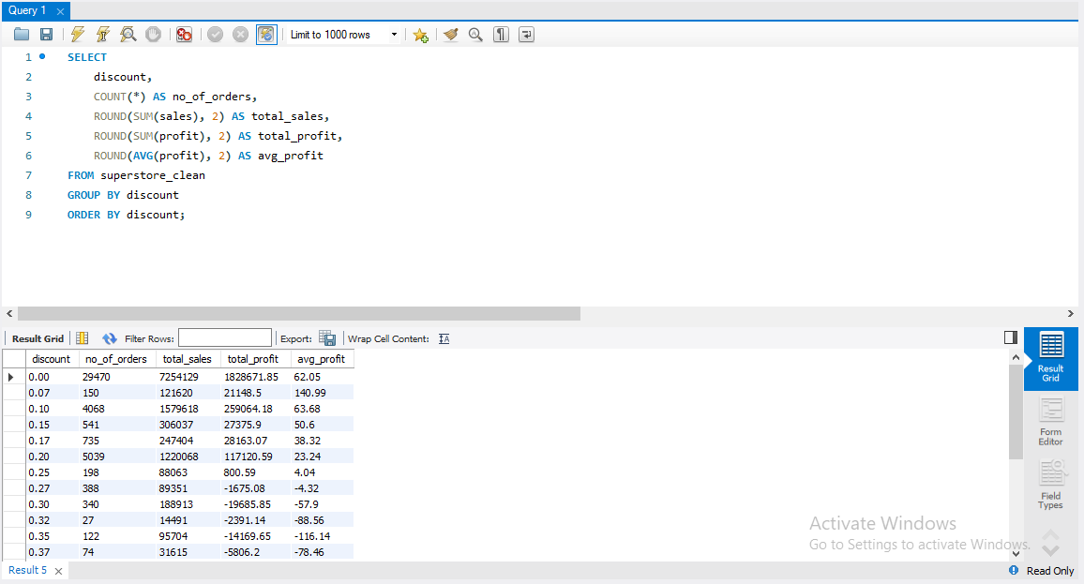
Appendix: Sample SQL Queries
The following queries were used to answer key business questions and prepare insights for visualization in Power BI.
Sales by Segment
Discount vs Profit Analysis

Slide 25
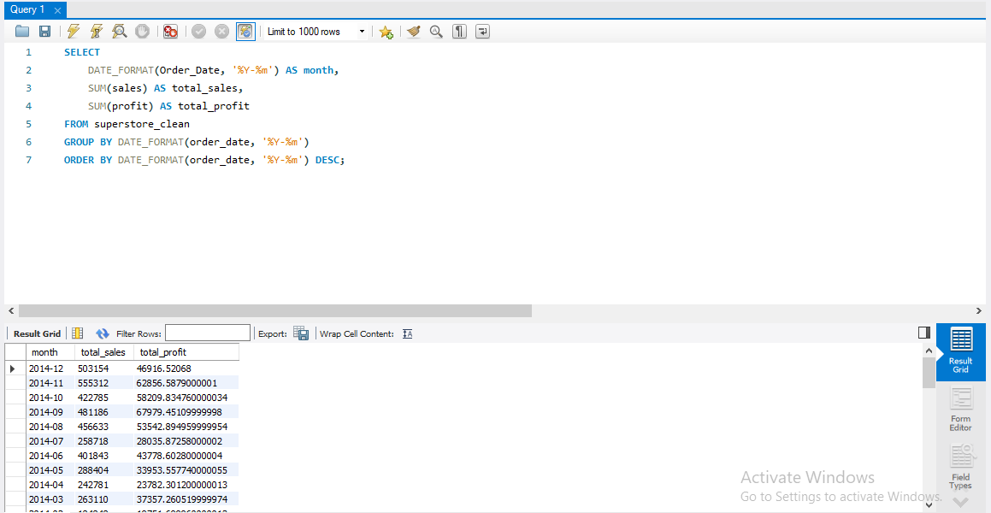
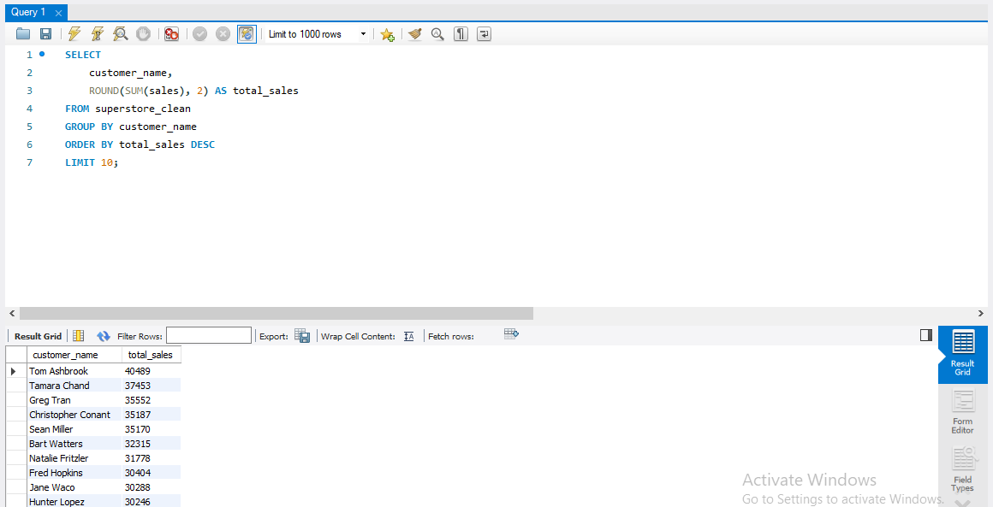
Monthly sales & profit Trend
Top Customers

